Slide 1
KX-NS PBX
Remote IP Extension
October 15, 2015
Panasonic System Networks
PBX SE team
Specifications are subject to change without notice.
Program enough TRS (Toll Restriction) level for remote IP extension.
“16. Notice for security” in this document is very important.
Notes:
1

Slide 2
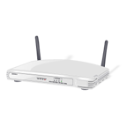


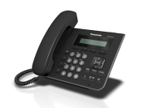
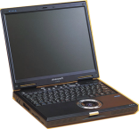

KX-NS1000 : Version 3 or later
Other KX-NS PBX : Any Version
1. Overview
Built-in MRG feature supports remote IP extension without VPN.
Following phones support this feature.
- KX-NT543/NT546/NT560 (Version up of phone software is required.)
- KX-NT511 and KX-NT550 series
- KX-UT / KX-HDV series
- 3rd party SIP phone with Blank UDP transmit capability. (Video phone is also supported.)
- KX-NT300 based software phone version 4
Other phones do not support this feature.
KX-UDT / KX-NT300 (hardware IP phone) series
Local Office
Remote Office
or Mobile Internet
WAN
11.22.33.44
WAN
22.33.44.55
Internet
192.168.0.101
LAN
192.168.0.1
LAN
Ext 101
192.168.0.201
Ext 104
Ext 102
192.168.1.201
Ext 103
IP address in above picture is example.
MRG = Media Relay Gateway
Notes:
2

Slide 3
2. Concept of Programming
Only 4 PBX programming are required for remote connection.
(1) PBX has to know global IP address of router. 11.22.33.44
(2) PBX has to know SIP port number of router. 15060
(3) Do not forget setting of default gateway. 192.168.0.1
(4) PBX has to know location of each IP extension. Local or Remote
Port Fwd is required to router.
“5060” is too famous as port for SIP.
“5060” has high risk for attacking by hacker.
So Port Fwd by router from 15060 to 5060 is
required. “15060” is example.
15060 to 192.168.0.101:5060
Local Office
Remote Office
or Mobile Internet
WAN
11.22.33.44
Port : 15060
WAN
22.33.44.55
Internet
192.168.0.101
Port : 5060
LAN
192.168.0.1
LAN
Ext 101
192.168.0.201
Ext 103
Ext 102
192.168.1.201
Fixed global IP address is required. DDNS is not supported.
Notes:
3

Slide 4
Chapter 1
PBX Programming

Slide 5
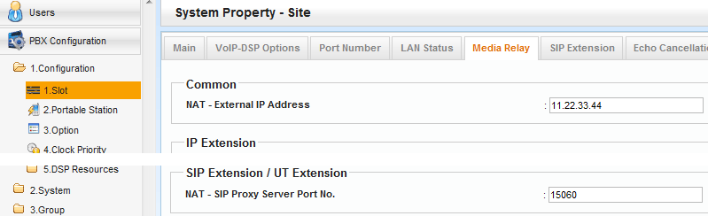
11. Assign Global IP Address of Router.
Local Office
WAN
11.22.33.44
Port : 15060
This document uses “15060” as example.
However x50xx such as “15060” and 50xx cannot be programmed from version 4.2 because these are famous as SIP port now.
3xxxx is recommended.
192.168.0.101
Port : 5060
LAN
192.168.0.1
Ext 101
192.168.0.201
Notes:
5

Slide 6
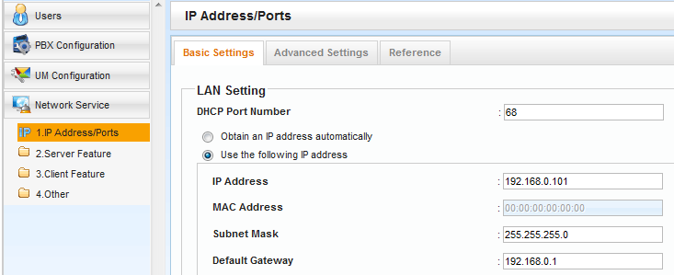
12. Assign Default Gateway.
Local Office
WAN
11.22.33.44
Port : 15060
Default gateway is required not only for remote IP extension but also for many other purpose.
192.168.0.101
Port : 5060
LAN
192.168.0.1
Ext 101
192.168.0.201
Notes:
6

Slide 7
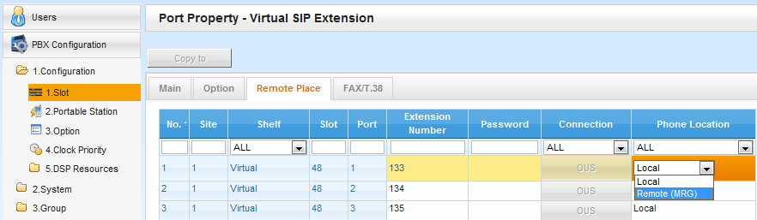
13. Assign Location of SIP Extension.
< 3rd party SIP Phone >
Local Office
Remote Office
or Mobile Internet
WAN
11.22.33.44
WAN
22.33.44.55
Internet
192.168.0.101
LAN
192.168.0.1
LAN
Ext 101
192.168.0.201
Ext 103
Ext 102
192.168.1.201
Notes:
7

Slide 8
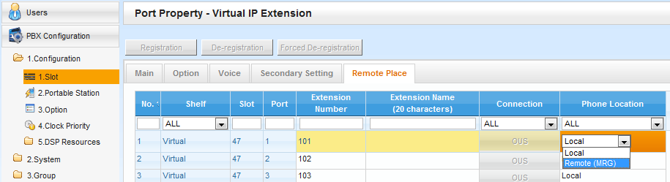
14. Assign Location of KX-NT500.
< KX-NT500 >
Notes:
8

Slide 9
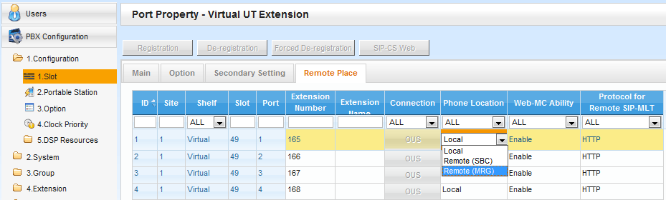

15. Assign Location of KX-UT.
< KX-UT >
SBC : Session Boarder Controller
(3rd party equipment is required.)
Secure communication is available using HTTPs for KX-UT.
- TR069(CWMP) is available with https.
- Maximum 20 KX-UT phone can use this feature.
Each one KX-NS1000 in one-look network supports 20 KX-UT
with this feature.
Notes:
9

Slide 10
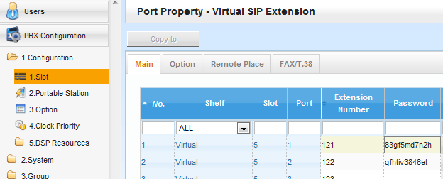
16. Notice for Security
Program enough TRS (Toll Restriction) level for remote IP extension.
International call should be restricted for remote IP extension.
Telephone number of international customer of PBX user can be
assigned to TRS exception code or system speed dial.
Hacker wants to call through some carriers of some countries.
Do not use easy SIP password for remote SIP extension such as
“1234abc”.
KX-NT/UT is registered by MAC address.
However other IP phone including KX-HDV is registered by
SIP password.
Notes:
10

Slide 11
Chapter 2
SIP Phone Setting
SIP Software Phone for Smart-phone by Media5 is used in this chapter as example.

Slide 12
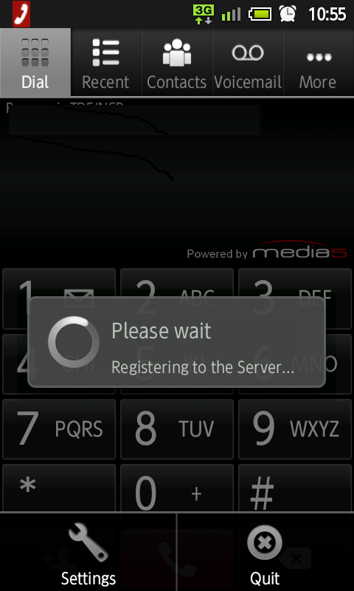
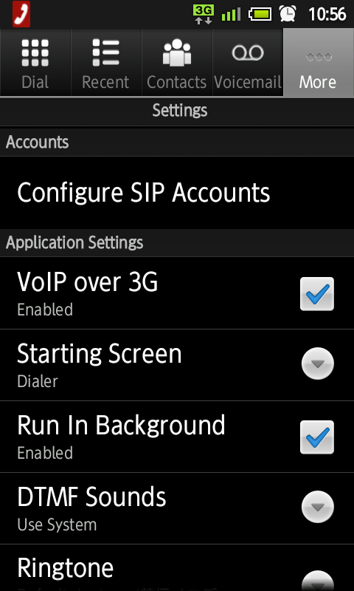
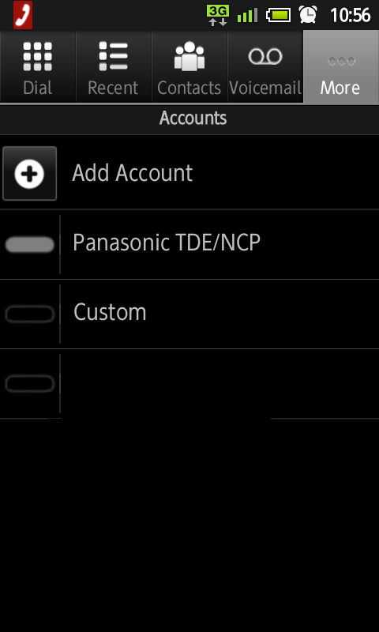
21. Configure SIP Account.
Notes:
12

Slide 13
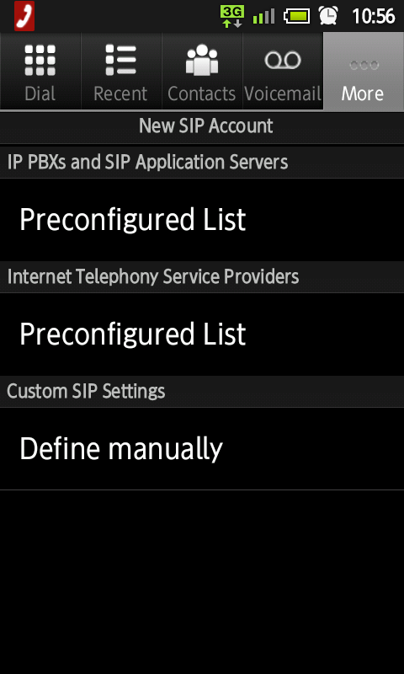
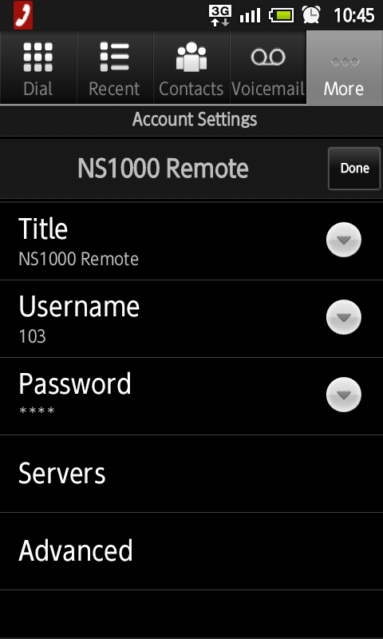
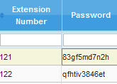
22. Assign Ext Number & PIN to log-in.
See next page.
Title = Reference
Username = Extension Number
Password = SIP Password of PBX
Notes:
13

Slide 14
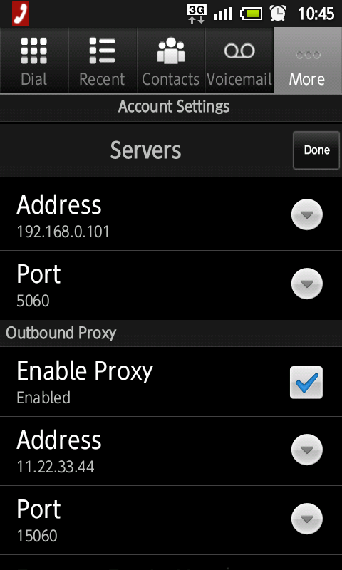
23. Assign Destination to log-in.
Local Office
WAN
11.22.33.44
Port : 15060
192.168.0.101
Port : 5060
LAN
192.168.0.1
Ext 101
192.168.0.201
Notes:
14

Slide 15
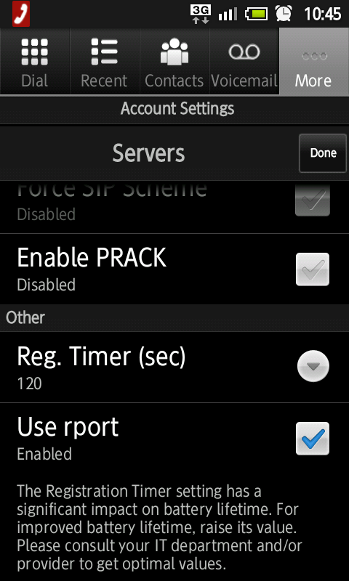
24. Enable “rport”.
Notes:
15

Slide 16
Chapter 3
KX-NT/UT Phone Setting

Slide 17
31. KX-NT500 : Assign Router as Destination.
Assign global IP address of router (11.22.33.44 for example) as destination instead of PBX local address (192.168.0.101 for example), when KX-NT phone is installed in remote office.
Local Office
Remote Office
or Mobile Internet
WAN
11.22.33.44
WAN
22.33.44.55
Internet
192.168.0.101
LAN
192.168.0.1
LAN
Ext 101
192.168.0.201
Ext 103
Ext 102
192.168.1.201
Notes:
17

Slide 18
32. KX-UT : Connect in Local Office.
1. Connect KX-UT phone in local office. (Not remote office)
2. Change PBX setting for this extension from “Local” to “Remote”.
3. Restart KX-UT by power off and on again. Error may display but OK.
4. Dispatch KX-UT to remote office.
Destination from remote office (11.22.33.44:15060 for example) is automatically informed to KX-UT phone from PBX at step 3.
Local Office
Remote Office
11.22.33.44
Port : 15060
WAN
11.22.33.44
Port : 15060
WAN
22.33.44.55
Internet
192.168.0.101
Port : 5060
192.168.0.1
LAN
Ext 101
192.168.0.201
Ext 102
192.168.1.201
Step 4
Dispatch
Ext 103
Ext 102
192.168.1.201
Operation is not required in remote office to connect KX-UT phone to PBX.
All you have to do is to connect KX-UT phone to LAN in remote office.
Notes:
18

Slide 19
Chapter 4
Router Programming
Port forwarding is required for router.

Slide 20
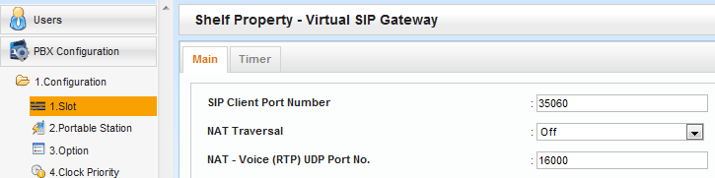
41. Port Fwd to DSP
< for 3rd party SIP Phone / KX-NT500 / KX-UT >
Protocol | Range of port number (WAN) | Destination | Description
RTP | 16000-16511(UDP) | 192.168.0.102 | to DSP#1-1
 | 16512-17023(UDP) | 192.168.0.103 | to DSP#1-2
 | 17024-17535(UDP) | 192.168.0.104 | to DSP#2-1
 | 17536-18047(UDP) | 192.168.0.105 | to DSP#2-2
WAN
LAN
< Reference of PBX setting >
Default is OK.
This parameter is common for IP trunk and IP extension.

Slide 21
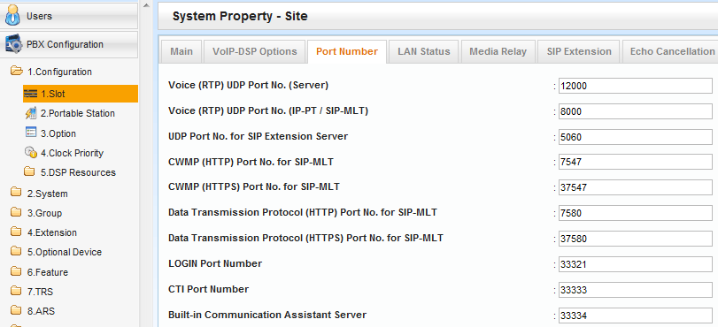
42. Port Fwd to PBX LAN : SIP
< for 3rd party SIP Phone >
Protocol | Port number | Destination
SIP | 15060(UDP) | 192.168.0.101:5060(UDP)
Port number conversion is required from 15060 to 5060.
< Reference of PBX setting >
Default is OK.

Slide 22
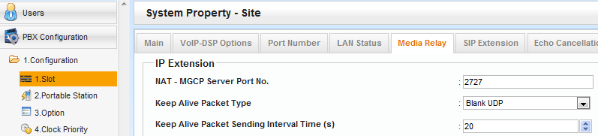
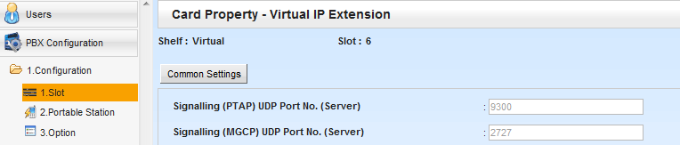
43. Port Fwd to PBX LAN : KX-NT500
< for KX-NT500 >
Protocol | Port number | Destination
MGCP | 2727(UDP) | 192.168.0.101
PTAP | 9300(UDP) | 192.168.0.101
< Reference of PBX setting >
Default is OK.

Slide 23
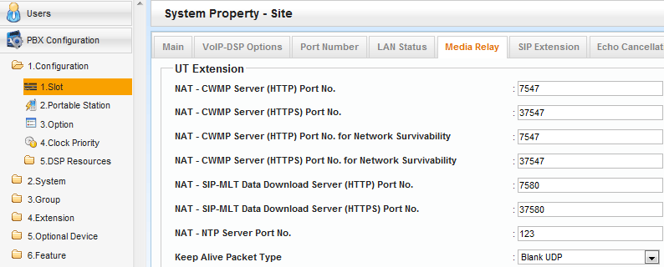
44. Port Fwd to PBX LAN : KX-UT
< for KX-UT >
Protocol | Port number | Destination
SIP | 15060(UDP) | 192.168.0.101:5060(UDP)
CWMP (HTTP) | 7547(TCP) | 192.168.0.101
CWMP (HTTPS) | 37547(TCP) | 192.168.0.101
SIP-MLT Data Download (HTTP) | 7580(TCP) | 192.168.0.101
SIP-MLT Data Download (HTTPS) | 37580(TCP) | 192.168.0.101
NTP | 123(UDP) | 192.168.0.101
< Reference of PBX setting > Default is OK.

Slide 24
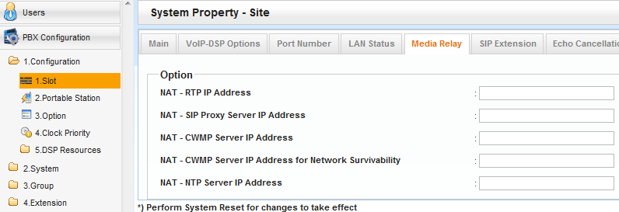
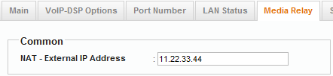
45. Port Fwd to PBX LAN : KX-UT
< Reference of PBX setting >
Default is OK. (These should be blank.)
This is applied to above,
if above is blank.

Slide 25
46. Condition for External Router
Condition for external router is as follows.
- Port Fwd by range setting becomes cause of “No voice” for
some router because 16000 (for example) is converted to other
number in the range (16000 - 16511).
In this case, port fwd for each number is required.
16000 to 192.168.0.102:16000
16001 to 192.168.0.102:16001
:
16511 to 192.168.0.102:16511
- If router has "SIP ALG" feature, this feature should
be disabled by programming.
!!! Important !!!
<Cisco router>
Router>enable
Router#configure terminal
Enter configuration commands, one per line. End with CNTL/Z.
Router(config)#no ip nat service sip udp port 5060
Router(config)#

Slide 26
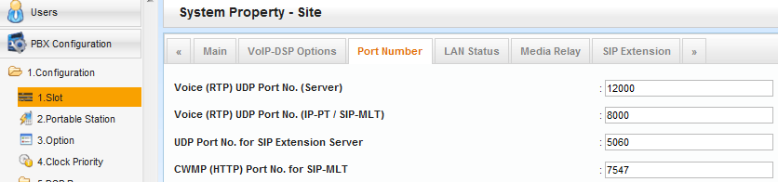
47. Condition for External Router
- If router does not support port convert such as “15060 to 5060”,
program “15060” as SIP UDP port to PBX.
15060
!!! Important !!!
Local Office
Remote Office
or Mobile Internet
WAN
11.22.33.44
Port : 15060
WAN
22.33.44.55
Internet
192.168.0.101
Port : 15060
LAN
192.168.0.1
LAN
Ext 101
192.168.0.201
Ext 103
Ext 102
192.168.1.201

Slide 27
Chapter 5
KX-NS1000 Built-in Router
MRG feature can work with KX-NS1000 built-in router.

Slide 28
51. Concept of Programming
Programming (1) and (3) are required for remote connection.
(1) PBX has to know global IP address of router. 11.22.33.44
(2) PBX has to know SIP port number of router. 15060
(3 Default gateway programming 192.168.0.101 (No need)
(4) PBX has to know location of each IP extension. Local or Remote
Fixed global IP address for WAN is required as next page.
Other settings such as Port Fwd are NOT required.
Local Office
Activation key KX-NSN101 is required to use WAN.
WAN
11.22.33.44
Port : 15060
Remote Office
or Mobile Internet
WAN
22.33.44.55
Internet
192.168.0.101
Port : 5060
LAN
LAN
Ext 101
192.168.0.201
Ext 103
Ext 102
192.168.1.201
Notes:
28

Slide 29
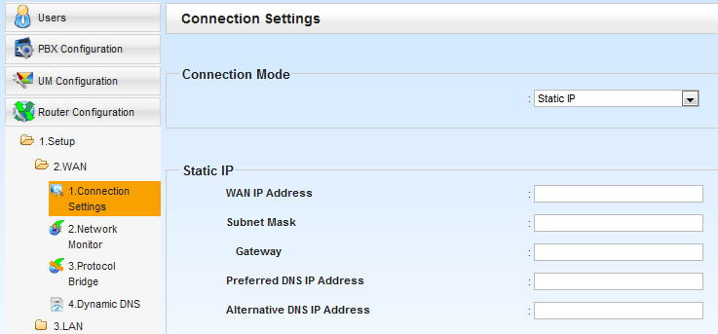
52. IP Address for WAN
Notes:
29

Slide 30
Thank you !

Slide 31
Revision
Date | No. | Change
April 17, 2014 | All | First release
June 2, 2014 | 46 | Condition for router was revised.
Nov 5, 2014 | 1 | Software phone version 4 supports MRG.
 | 46 | Condition for router was revised.
April 2, 2015 | 1 (Page 2) | KX-HDV was added.
 | 2 (Page 3) | DDNS is not supported.
 | 2 (Page 3) 11 (Page 5) 51 (Page 28) | This document uses “15060” as example. However x50xx such as “15060” and 50xx cannot be programmed from version 4.2 because these are famous as SIP port now. 3xxxx is recommended.
 | 16 (Page 10) 22 (Page 13) | Notice for security was added.
 | 47 (Page 26) | Condition for router was added.
Oct 15, 2015 | 16 (Page 10) | Notice for security was revised.
Notes:
31

