Slide 1
HTS Technical Documents & Video
 | Name of material | Web site | URL | Release
Firmware and Manual | - Firmware - Manual | Panasonic.net (Support > Business & Professional> Office Products > Office Communication System > KX-HTS Series > KX-HDV Series Firmware) | http://panasonic.net/pcc/support/pbx/ | Sep.2016
Feature and Specification (Documents) | - HTS Basic spec | CS-KMS (PBX > Solution & Support > Seminar Material > KX-HTS Seminar Materials) | https://bizpartner.panasonic.net/cskms/pbx/seminer-material-document/kx-hts-seminar-materials-draft | Sep.2016
Step by Step Guide (Documents) | - Initial Set-up - Basic Call - VM & Gmail - KX-HDV - KX-NTV - SIP Soft-phone - SIP Ext WAN - SIP Trunk - Maintenance | CS-KMS (PBX > Solution & Support > Seminar Material > KX-HTS Seminar Materials) | https://bizpartner.panasonic.net/cskms/pbx/seminer-material-document/kx-hts-seminar-materials-draft | Sep.2016
Step by Step Guide (Video) | KX-HTS Series Setup Guide - Initialize - Web MC - Phone Connection - CO Connection - IP Configuration - Basic Call - VM and Gmail - KX-HDV - KX-NTV | YouTube | http://channel.panasonic.com/contents/18796/ and more | Sep.2016

Slide 2
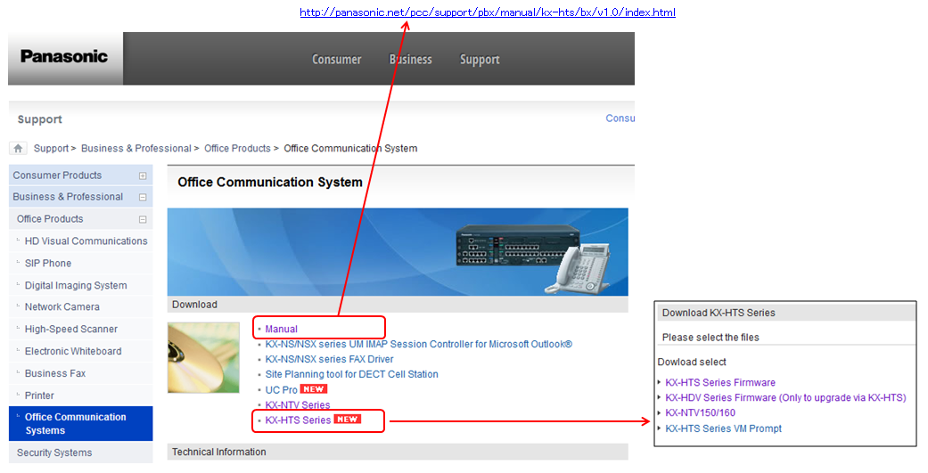
HTS Technical Documents & Video
Firmware and Manual (HTS)
http://panasonic.net/pcc/support/pbx/

Slide 3
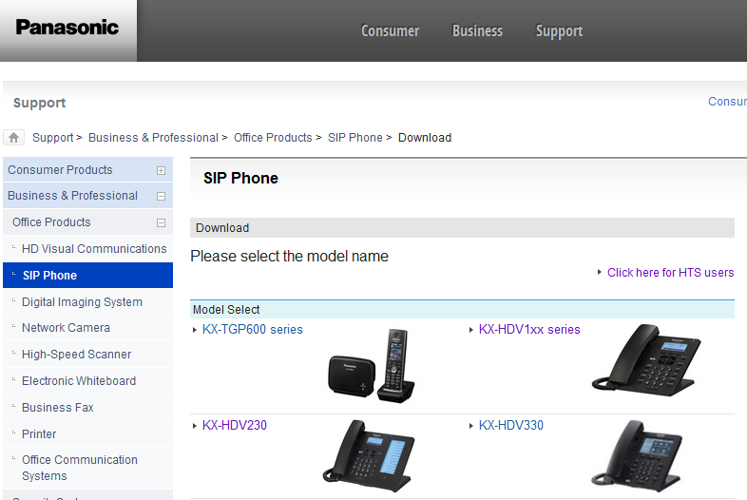
HTS Technical Documents & Video
Firmware and Manual (HDV/NTV)
http://panasonic.net/pcc/support/sipphone/

Slide 4
HTS Technical Documents & Video
Step by Step Guide (Video)
# | file name | time | Channel Panasonic
1 | KX-HTS Step By Step Guide aid 01-01 Initialize.mp4 | 0:01:09 | http://channel.panasonic.com/contents/18796/
2 | KX-HTS Step By Step Guide aid 01-02 WebMC(EasySetup).mp4 | 0:02:10 | http://channel.panasonic.com/contents/18797/
3 | KX-HTS Step By Step Guide aid 01-03 Phone Connection.mp4 | 0:06:34 | http://channel.panasonic.com/contents/18798/
4 | KX-HTS Step By Step Guide aid 01-04 CO Connection.mp4 | 0:01:17 | http://channel.panasonic.com/contents/18799/
5 | KX-HTS Step By Step Guide aid 01-05 IP Configuration.mp4 | 0:04:33 | http://channel.panasonic.com/contents/18800/
6 | KX-HTS Step By Step Guide aid 02-01-01 Basic Call - Incoming call-Part1.mp4 | 0:02:55 | http://channel.panasonic.com/contents/18801/
7 | KX-HTS Step By Step Guide aid 02-01-02 Basic Call - Incoming call-Part2.mp4 | 0:04:05 | http://channel.panasonic.com/contents/18802/
8 | KX-HTS Step By Step Guide aid 02-02-01 Basic Call - Outgoing call -TRS.mp4 | 0:04:31 | http://channel.panasonic.com/contents/18803/
9 | KX-HTS Step By Step Guide aid 02-02-02 Basic Call - Outgoing call - Emergency Call.mp4 | 0:02:13 | http://channel.panasonic.com/contents/18804/
10 | KX-HTS Step By Step Guide aid 03 VM and Gmail.mp4 | 0:10:52 | http://channel.panasonic.com/contents/18805/
11 | KX-HTS Step By Step Guide aid 04-01 KX-HDV - Plug and Play.mp4 | 0:03:05 | http://channel.panasonic.com/contents/18806/
12 | KX-HTS Step By Step Guide aid 04-02-01 KX-HDV - HDV430 Video Call Part1.mp4 | 0:01:30 | http://channel.panasonic.com/contents/18807/
13 | KX-HTS Step By Step Guide aid 04-02-02 KX-HDV - HDV430 Video Call Part2.mp4 | 0:01:06 | http://channel.panasonic.com/contents/18808/
14 | KX-HTS Step By Step Guide aid 04-02-03 KX-HDV - HDV430 Video Call Part3.mp4 | 0:01:10 | http://channel.panasonic.com/contents/18809/
15 | KX-HTS Step By Step Guide aid 05-01 KX-NTV To accept NTV (HTS Programming).mp4 | 0:02:13 | http://channel.panasonic.com/contents/18831/
16 | KX-HTS Step By Step Guide aid 05-02 KX-NTV Initialize NTV.mp4 | 0:03:22 | http://channel.panasonic.com/contents/18832/
17 | KX-HTS Step By Step Guide aid 05-03 KX-NTV To setup IW_exe.mp4 | 0:02:21 | http://channel.panasonic.com/contents/18833/
18 | KX-HTS Step By Step Guide aid 05-04 KX-NTV First access to NTV.mp4 | 0:02:45 | http://channel.panasonic.com/contents/18834/
19 | KX-HTS Step By Step Guide aid 05-05 KX-NTV Connect NTV150 via WiFi.mp4 | 0:03:50 | http://channel.panasonic.com/contents/18835/
20 | KX-HTS Step By Step Guide aid 05-06 KX-NTV Set SIP Parameter to NTV150.mp4 | 0:01:57 | http://channel.panasonic.com/contents/18836/
21 | KX-HTS Step By Step Guide aid 05-07 KX-NTV Set SIP Parameter to NTV160.mp4 | 0:01:59 | http://channel.panasonic.com/contents/18837/
22 | KX-HTS Step By Step Guide aid 05-08 KX-NTV Register NTV to HDV430.mp4 | 0:01:55 | http://channel.panasonic.com/contents/18838/
23 | KX-HTS Step By Step Guide aid 05-09 KX-NTV TEST, NTV150, NTV160, HDV430.mp4 | 0:03:18 | http://channel.panasonic.com/contents/18839/
 | Total time | 1:10:50

Slide 5
HTS Sales Documents & Video
 | Name of material | Web site | URL | Release
Sales Guide (Documents) | - Product Presentation - Brochure | Panasonic.net (Business > Business Solutions > Communication Solutions > Business Communication Systems > Products > KX-HTS32/824) | http://panasonic.net/pcc/products/pbx/products/ | Sep.2016
Product introduction (Video) | - Panasonic Compact Hybrid IP-PBX | YouTube | KX-HTS824 https://www.youtube.com/watch?v=BUPHcTMEB-0 KX-HTS32 https://www.youtube.com/watch?v=PyI_yRPEDcM | Sep.2016
Support terminal (Documents) | - HTS Terminals Support | Panasonic.net (Support > Business & Professional> Office Products > Office Communication System > KX-HTS Series > KX-HDV Series Firmware) | http://panasonic.net/pcc/support/pbx/download/hts/index1.html | Sep.2016

Slide 6

HTS Sales Documents & Video
Product Presentation and Brochure
(Documents)
http://panasonic.net/pcc/products/pbx/

Slide 7
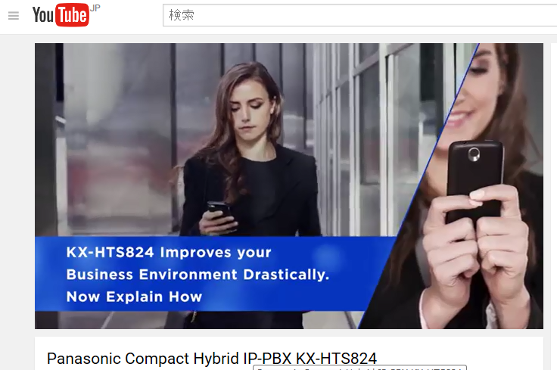
HTS Sales Documents & Video
Product introduction (Sales Video)
KX-HTS824
https://www.youtube.com/watch?v=BUPHcTMEB-0
KX-HTS32
https://www.youtube.com/watch?v=PyI_yRPEDcM

